Slide 1
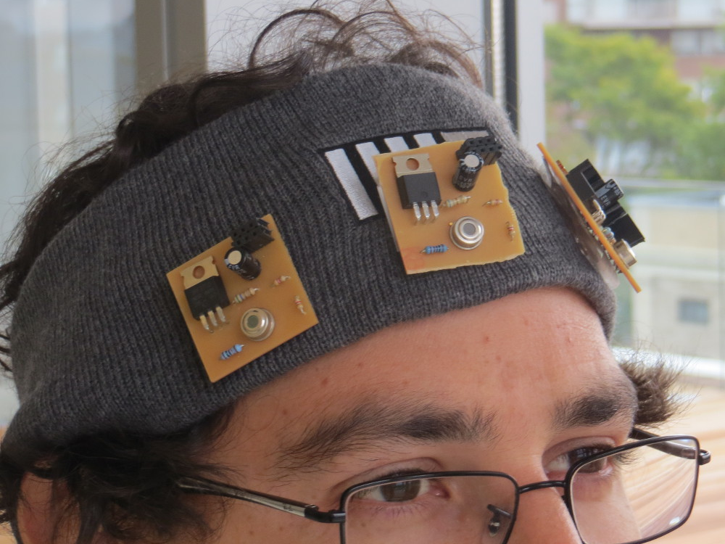
Digital synesthesia
Using Mobile Technology to Interact with Our World
PhD Thesis By:
Santiago Alfaro
Committee:
V. Michael Bove Jr.
Joseph Paradiso
Kevin Slavin
Notes:
Hello Welcome
Thanks to readers.

Slide 2
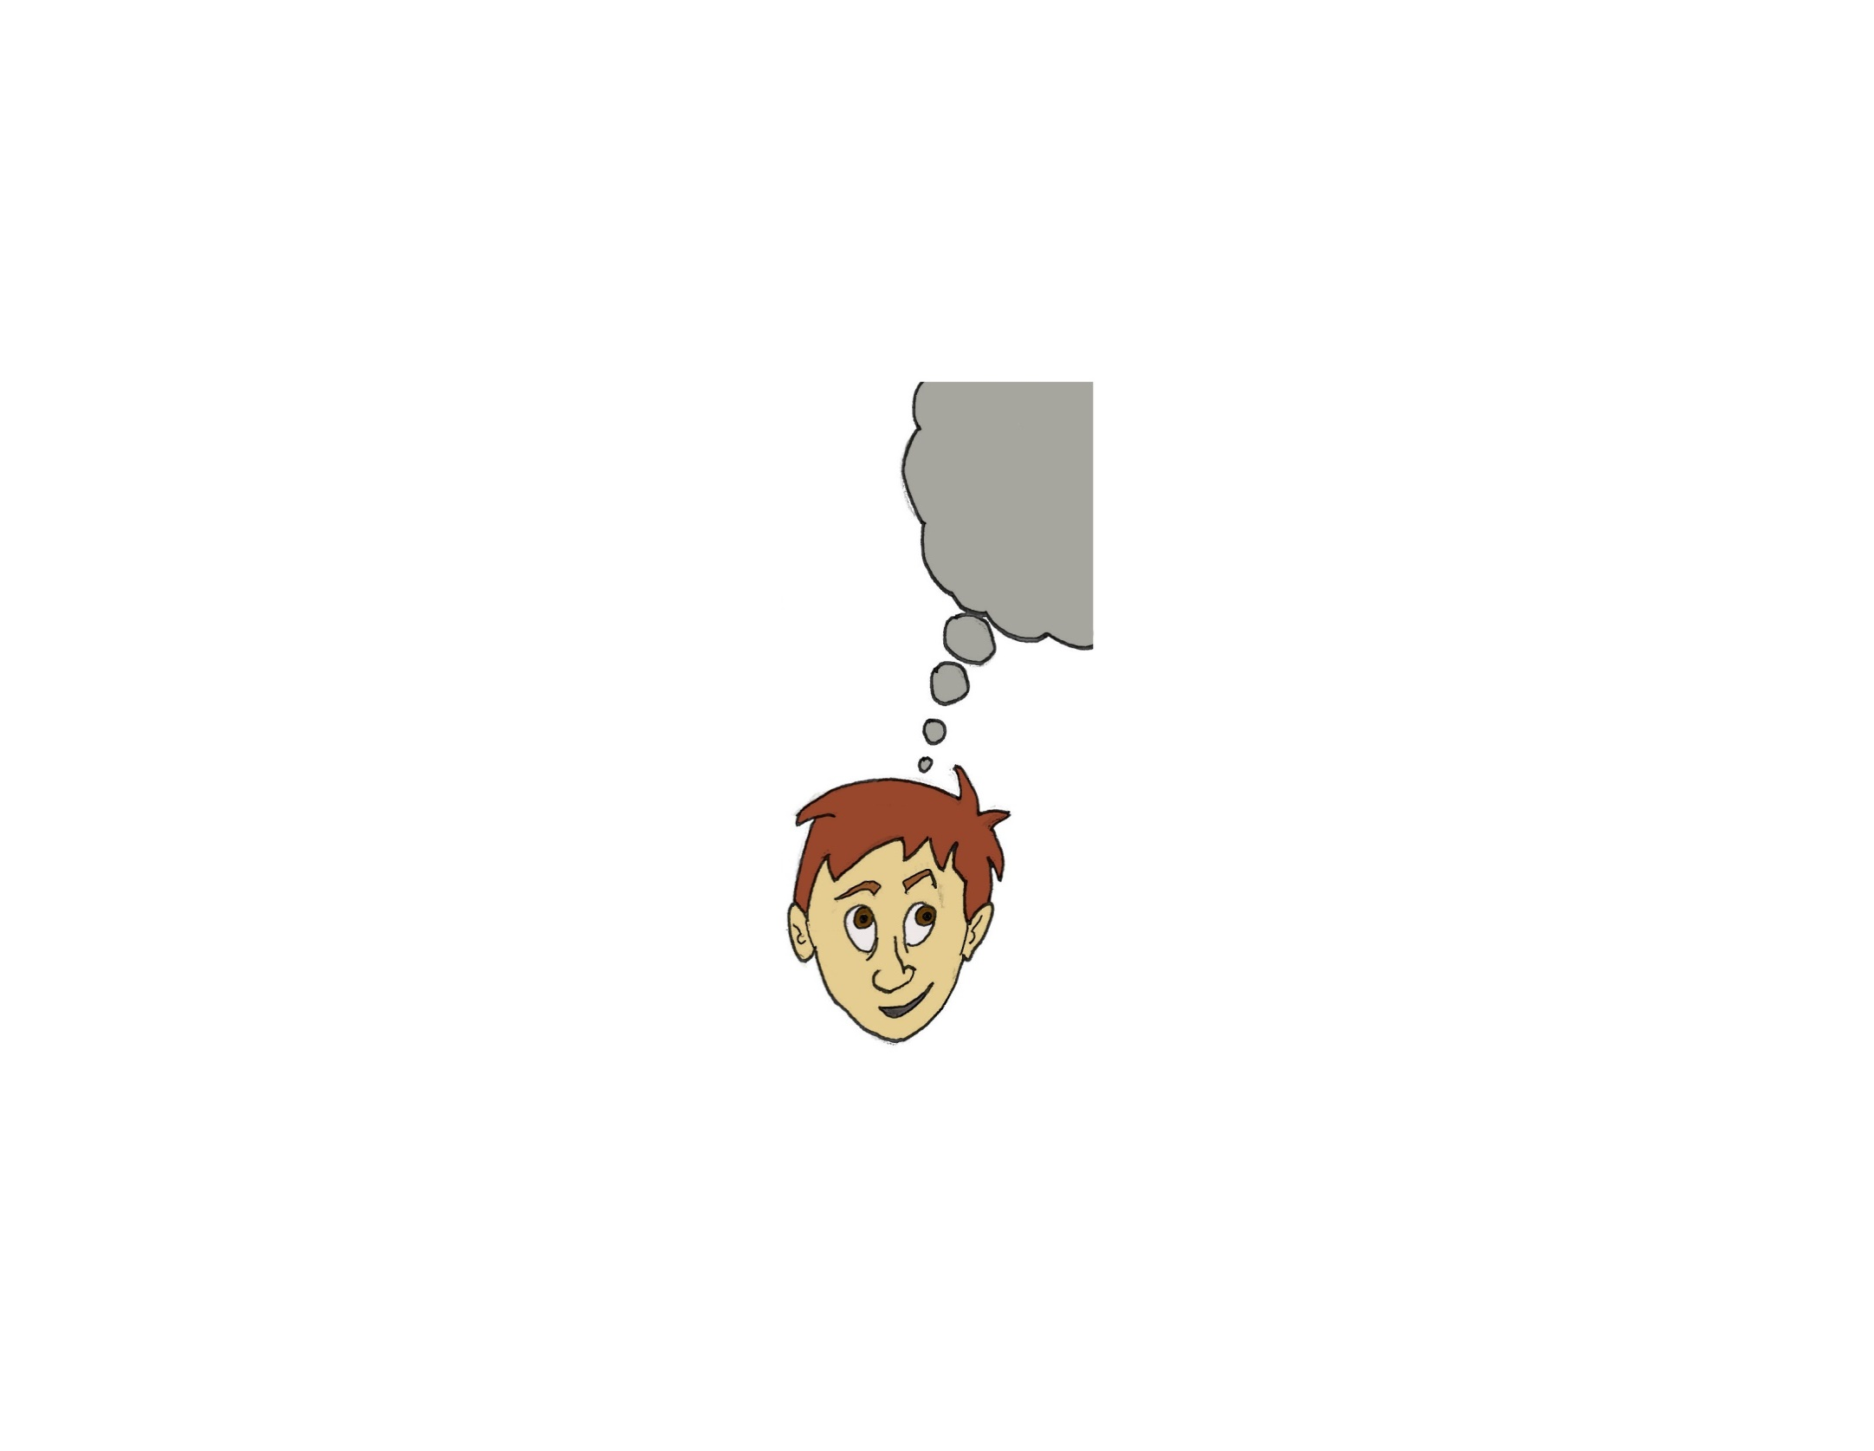
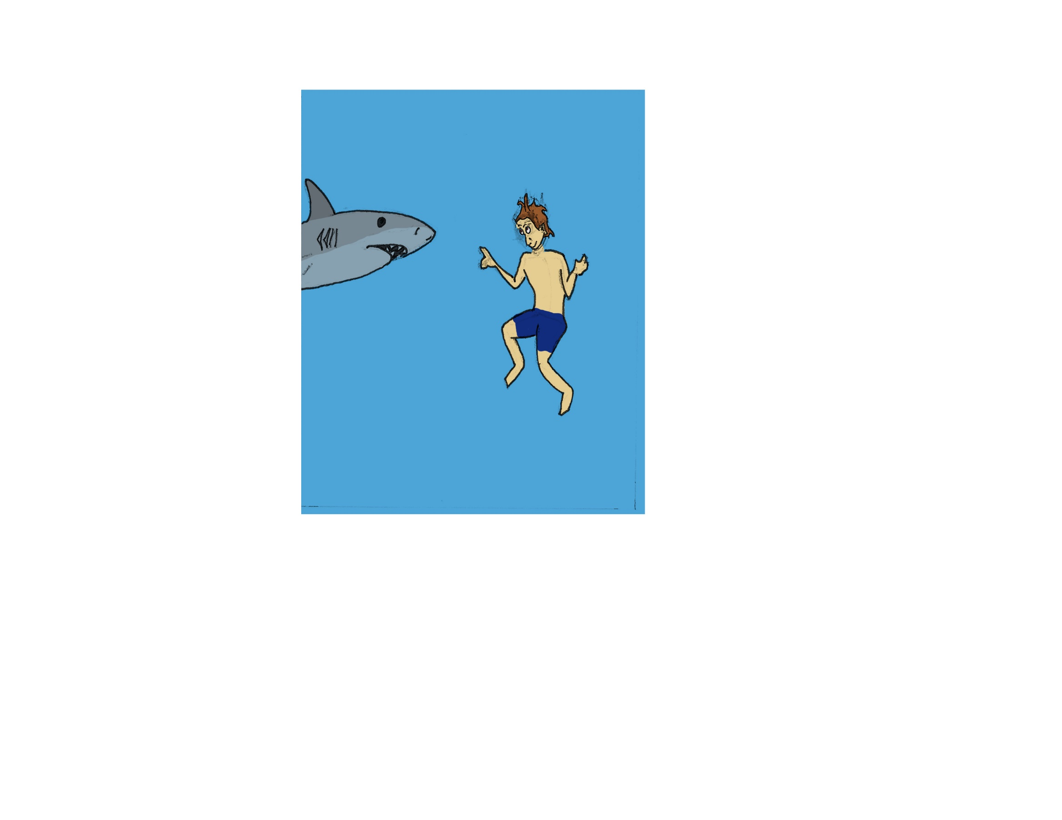
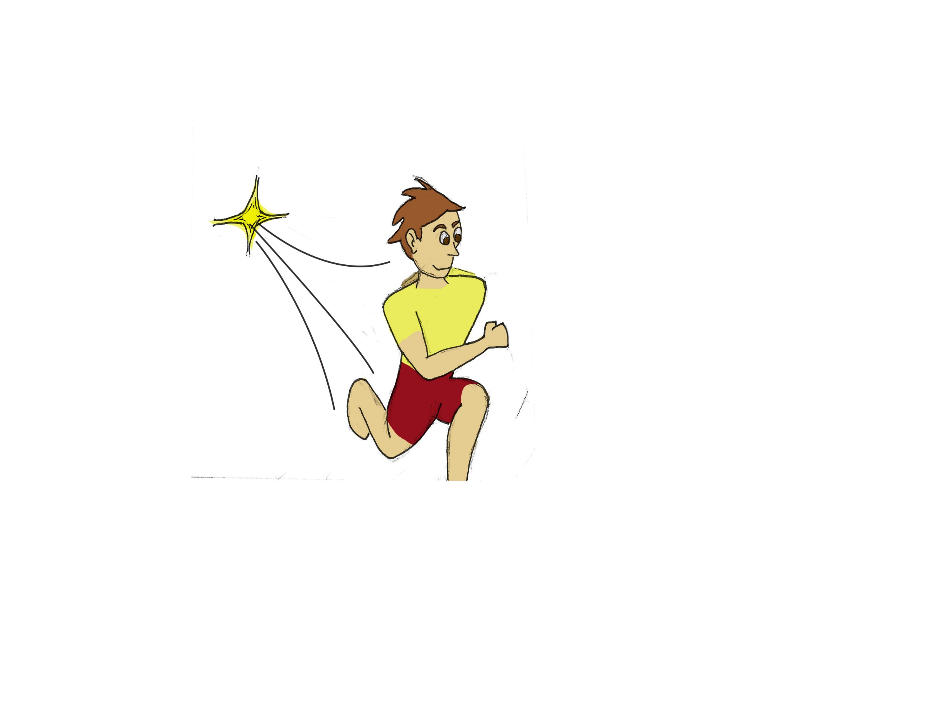
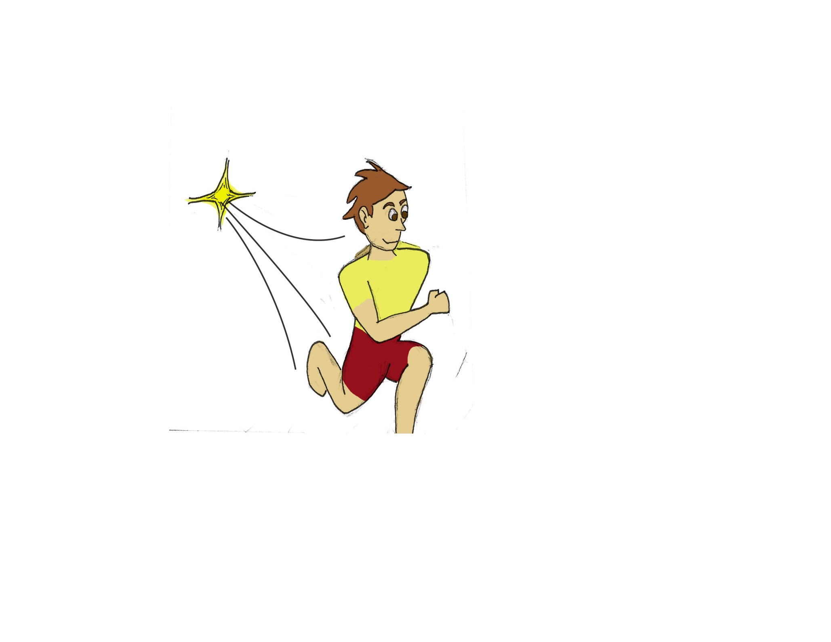

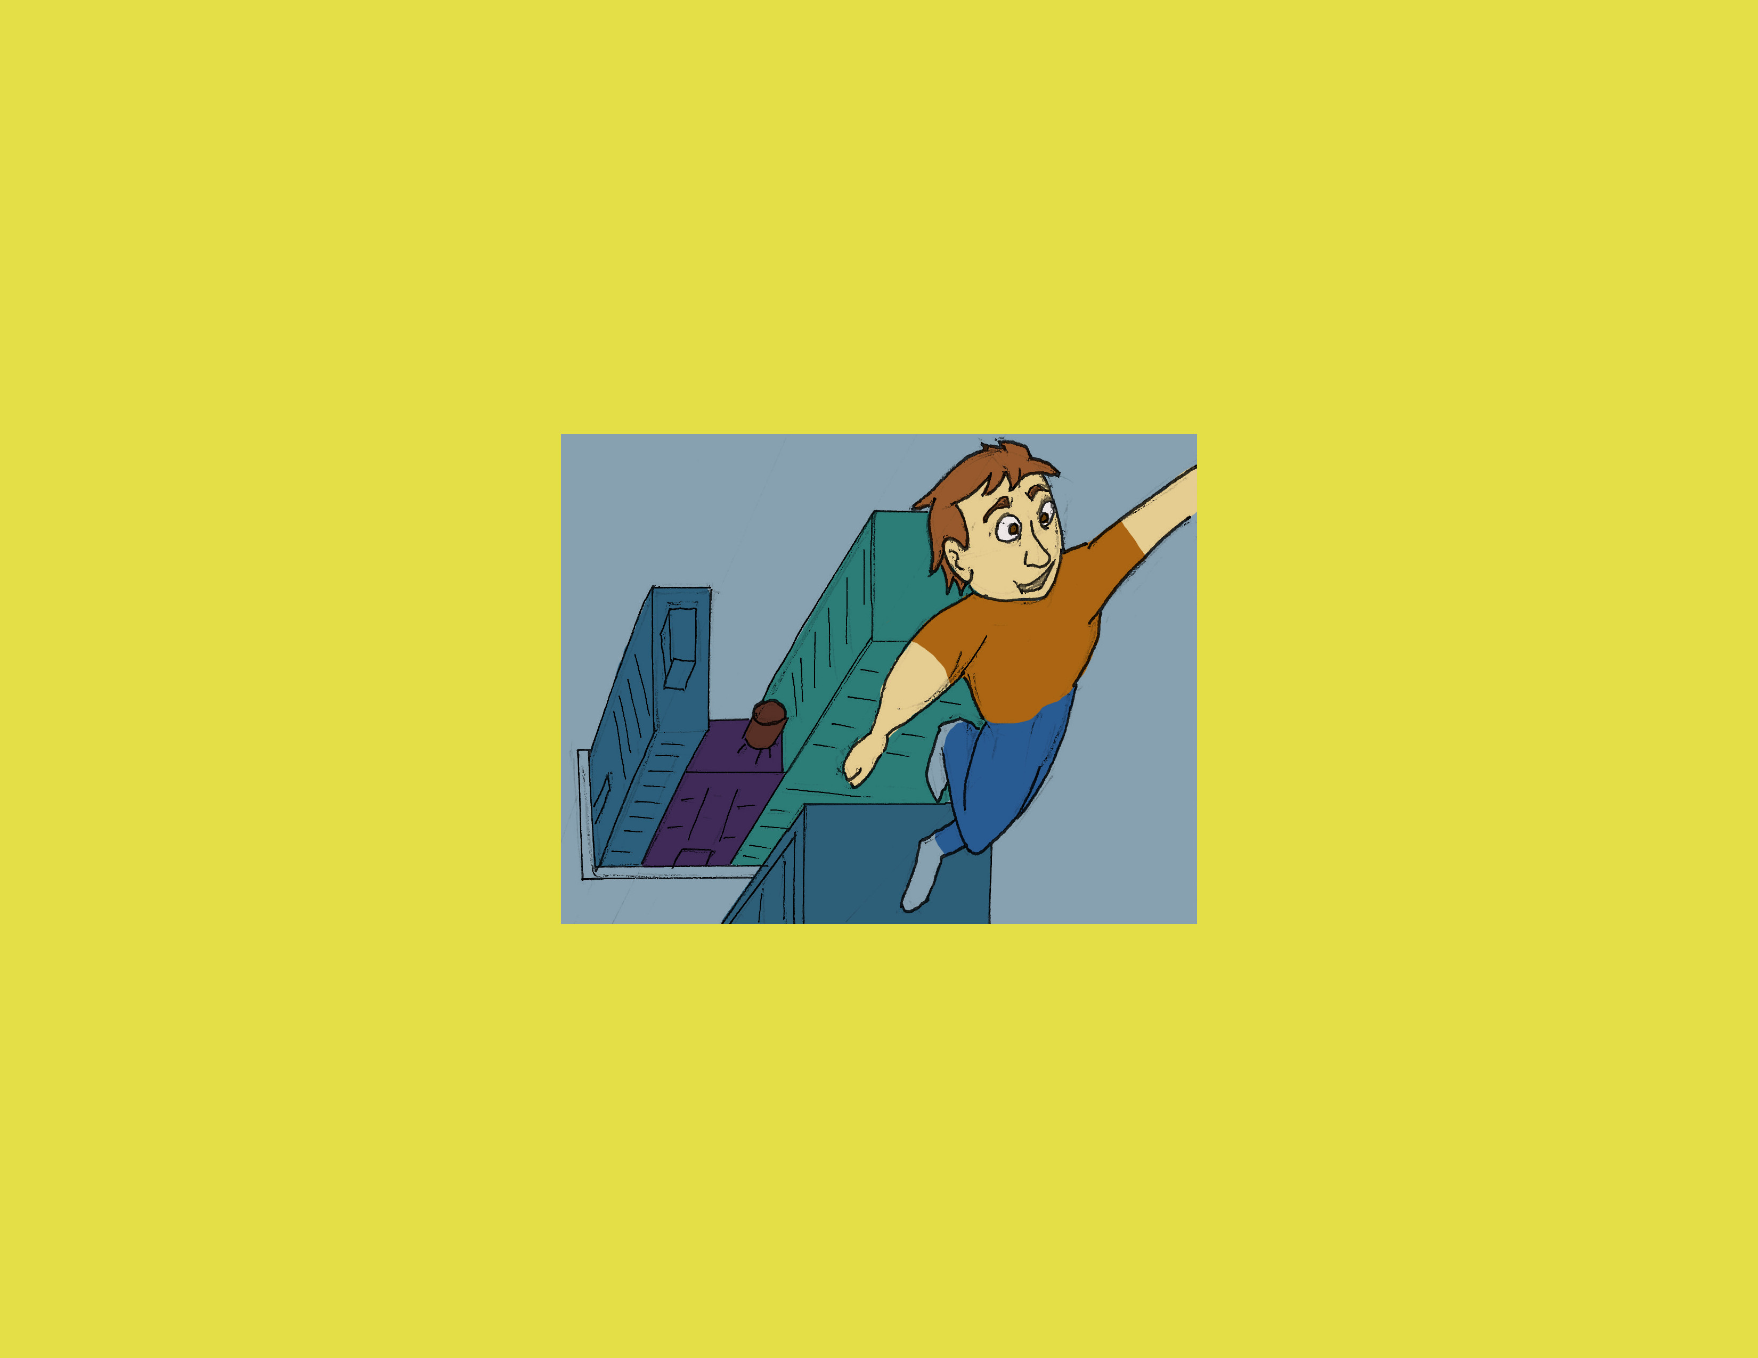
Humans have dreamt of going past our physical capabilities like…
… Breathing under water…
… having super-human Speed…
… or flying.
… going to space…
Notes:
Intro: Dreams:
Dreams - breathing under water – speed – space – flying.

Slide 3
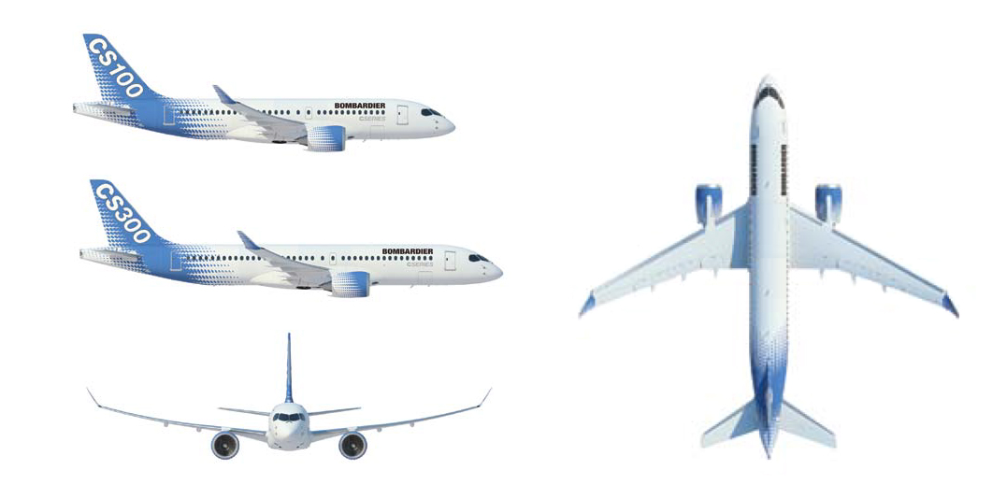
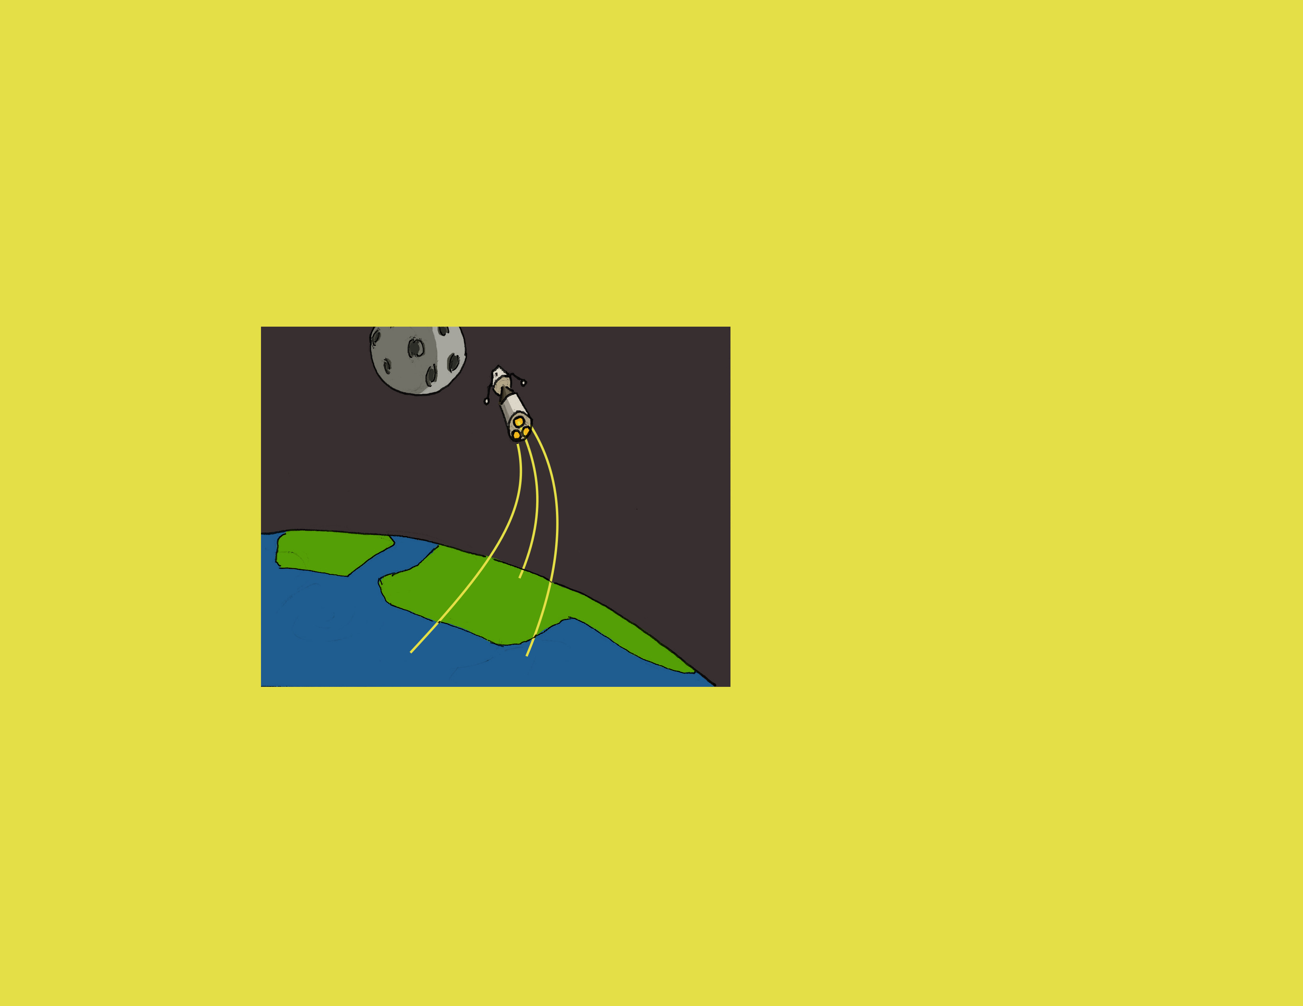
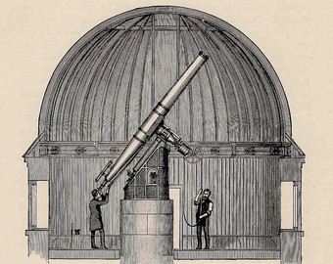
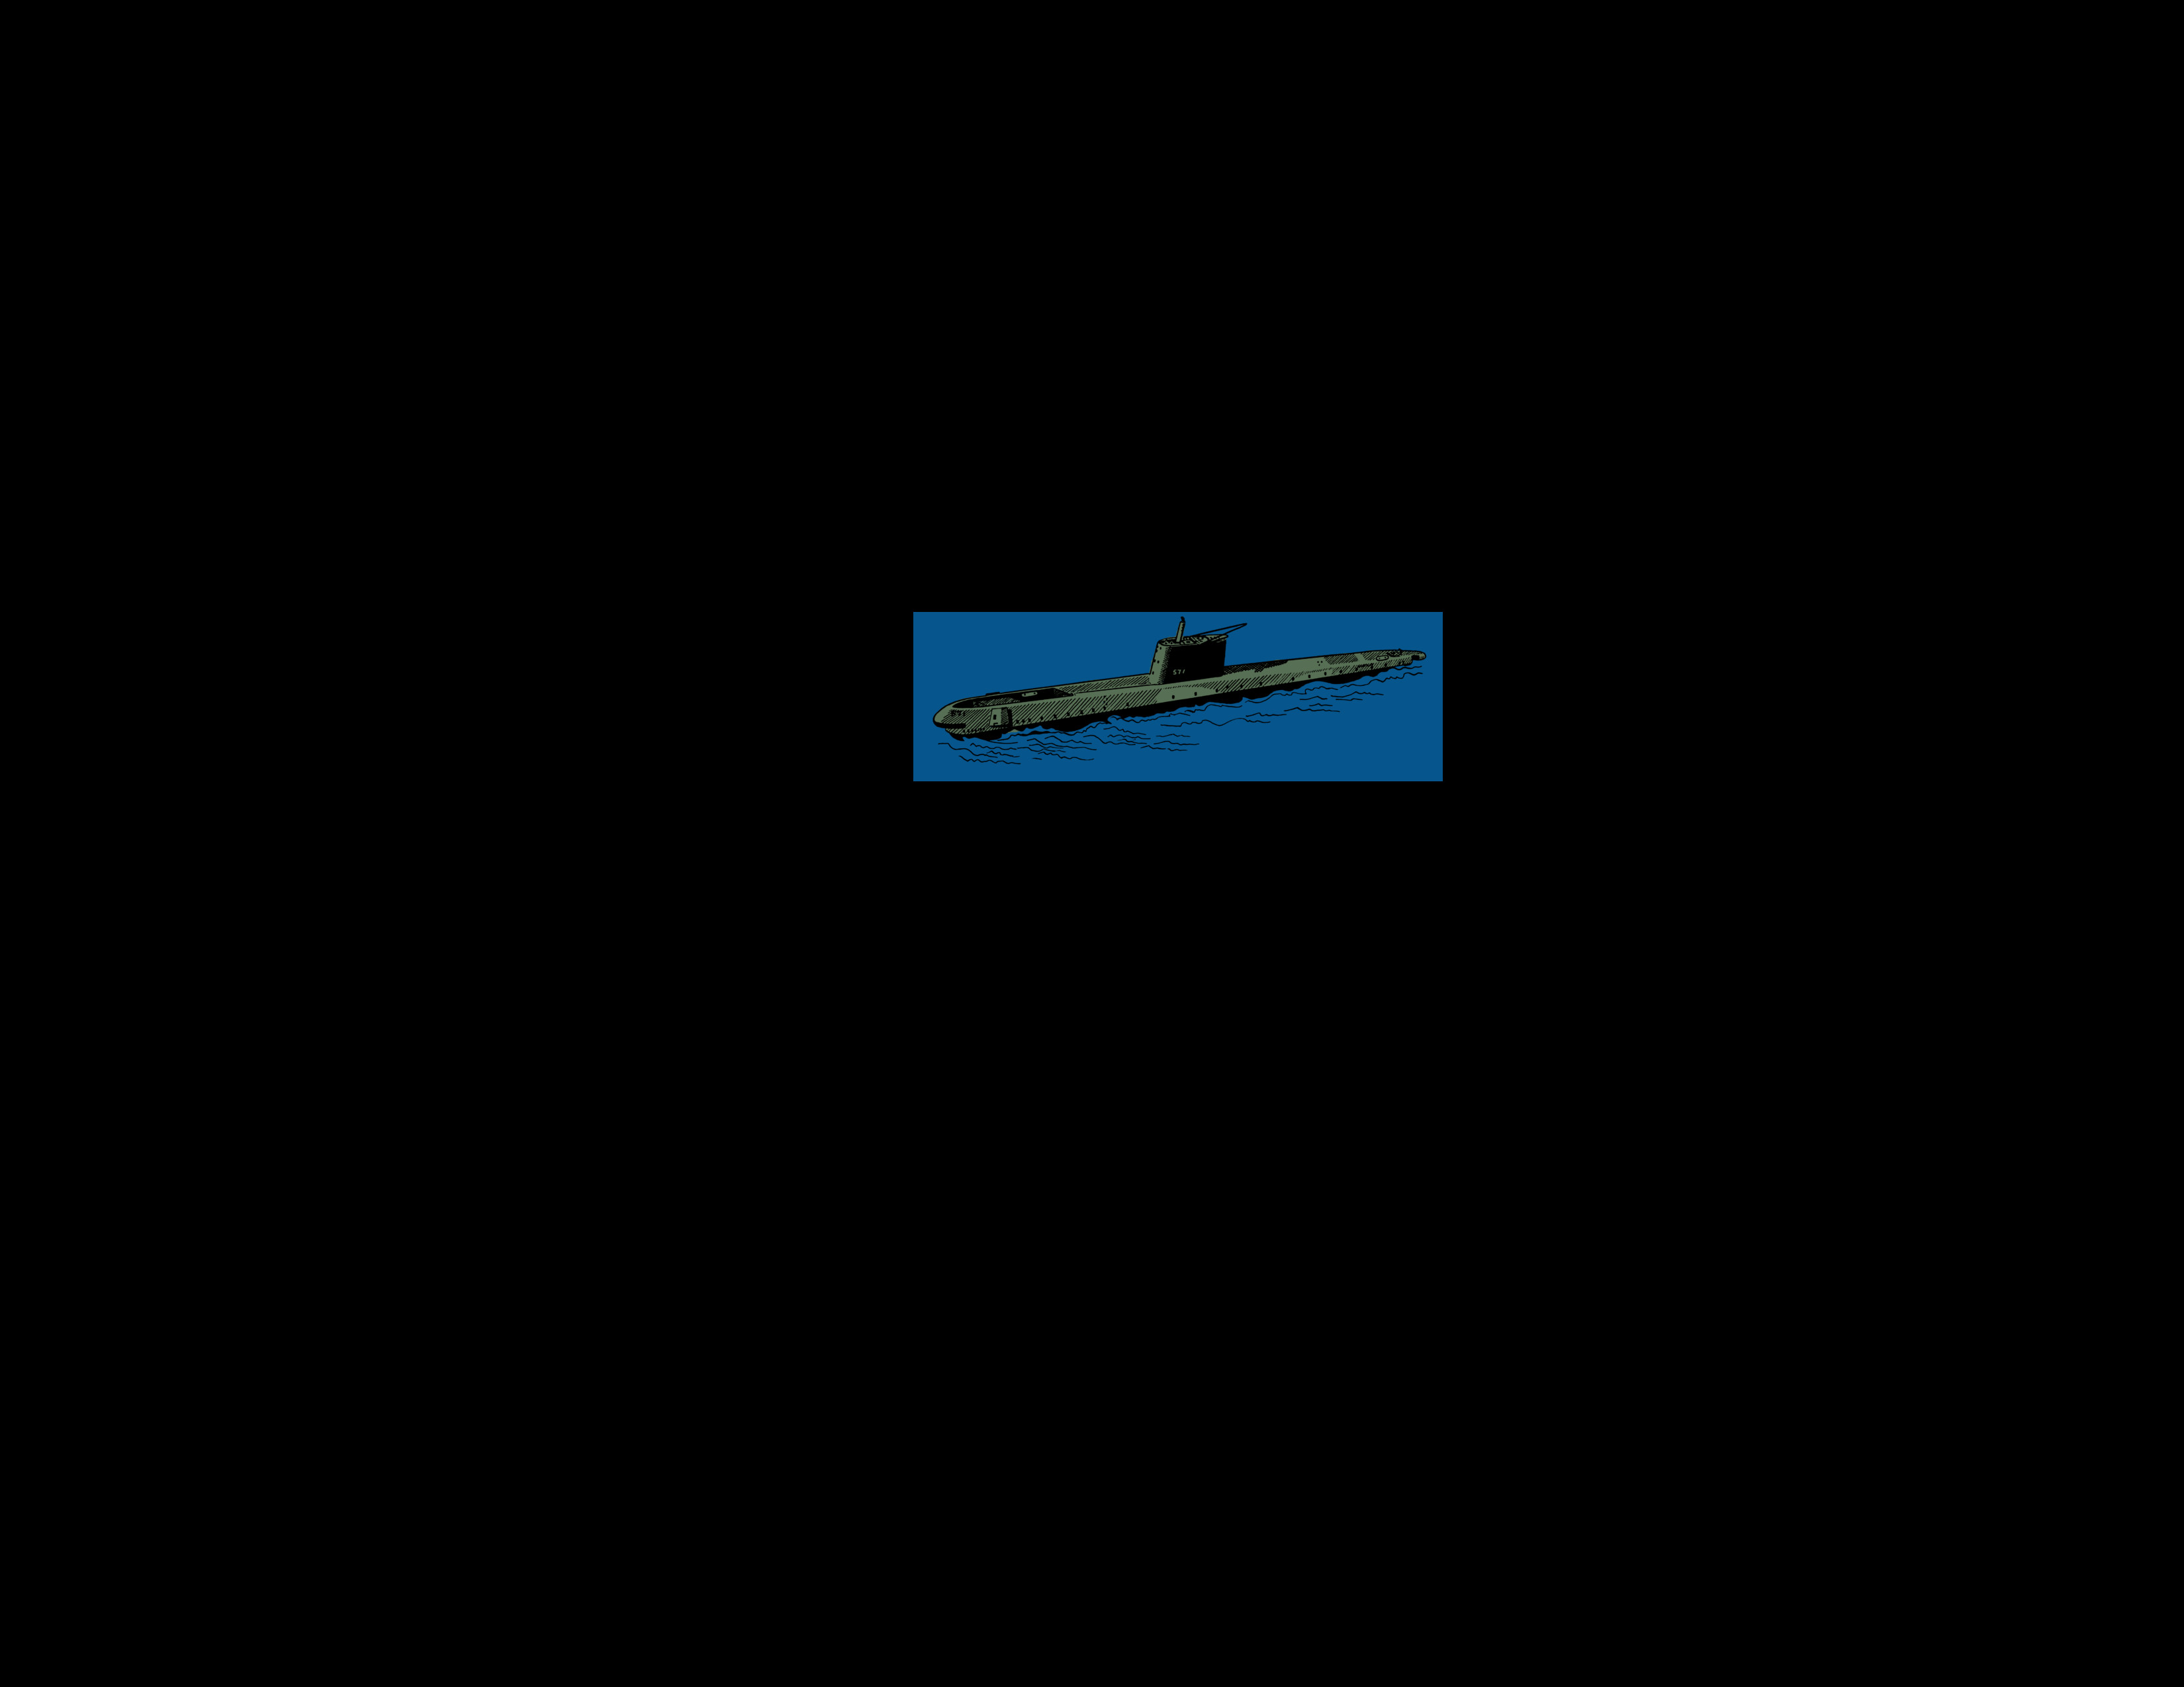

WE have reached some dreams
AND By UNDERSTANDING OUR WORLD
With technology
Notes:
Intro: Technology

Slide 4
Other dreams are about our senses…
Notes:
Intro: Other dreams dealing with senses
Senses – Sight – sound – porf X – Spidey - Quickening

Slide 5
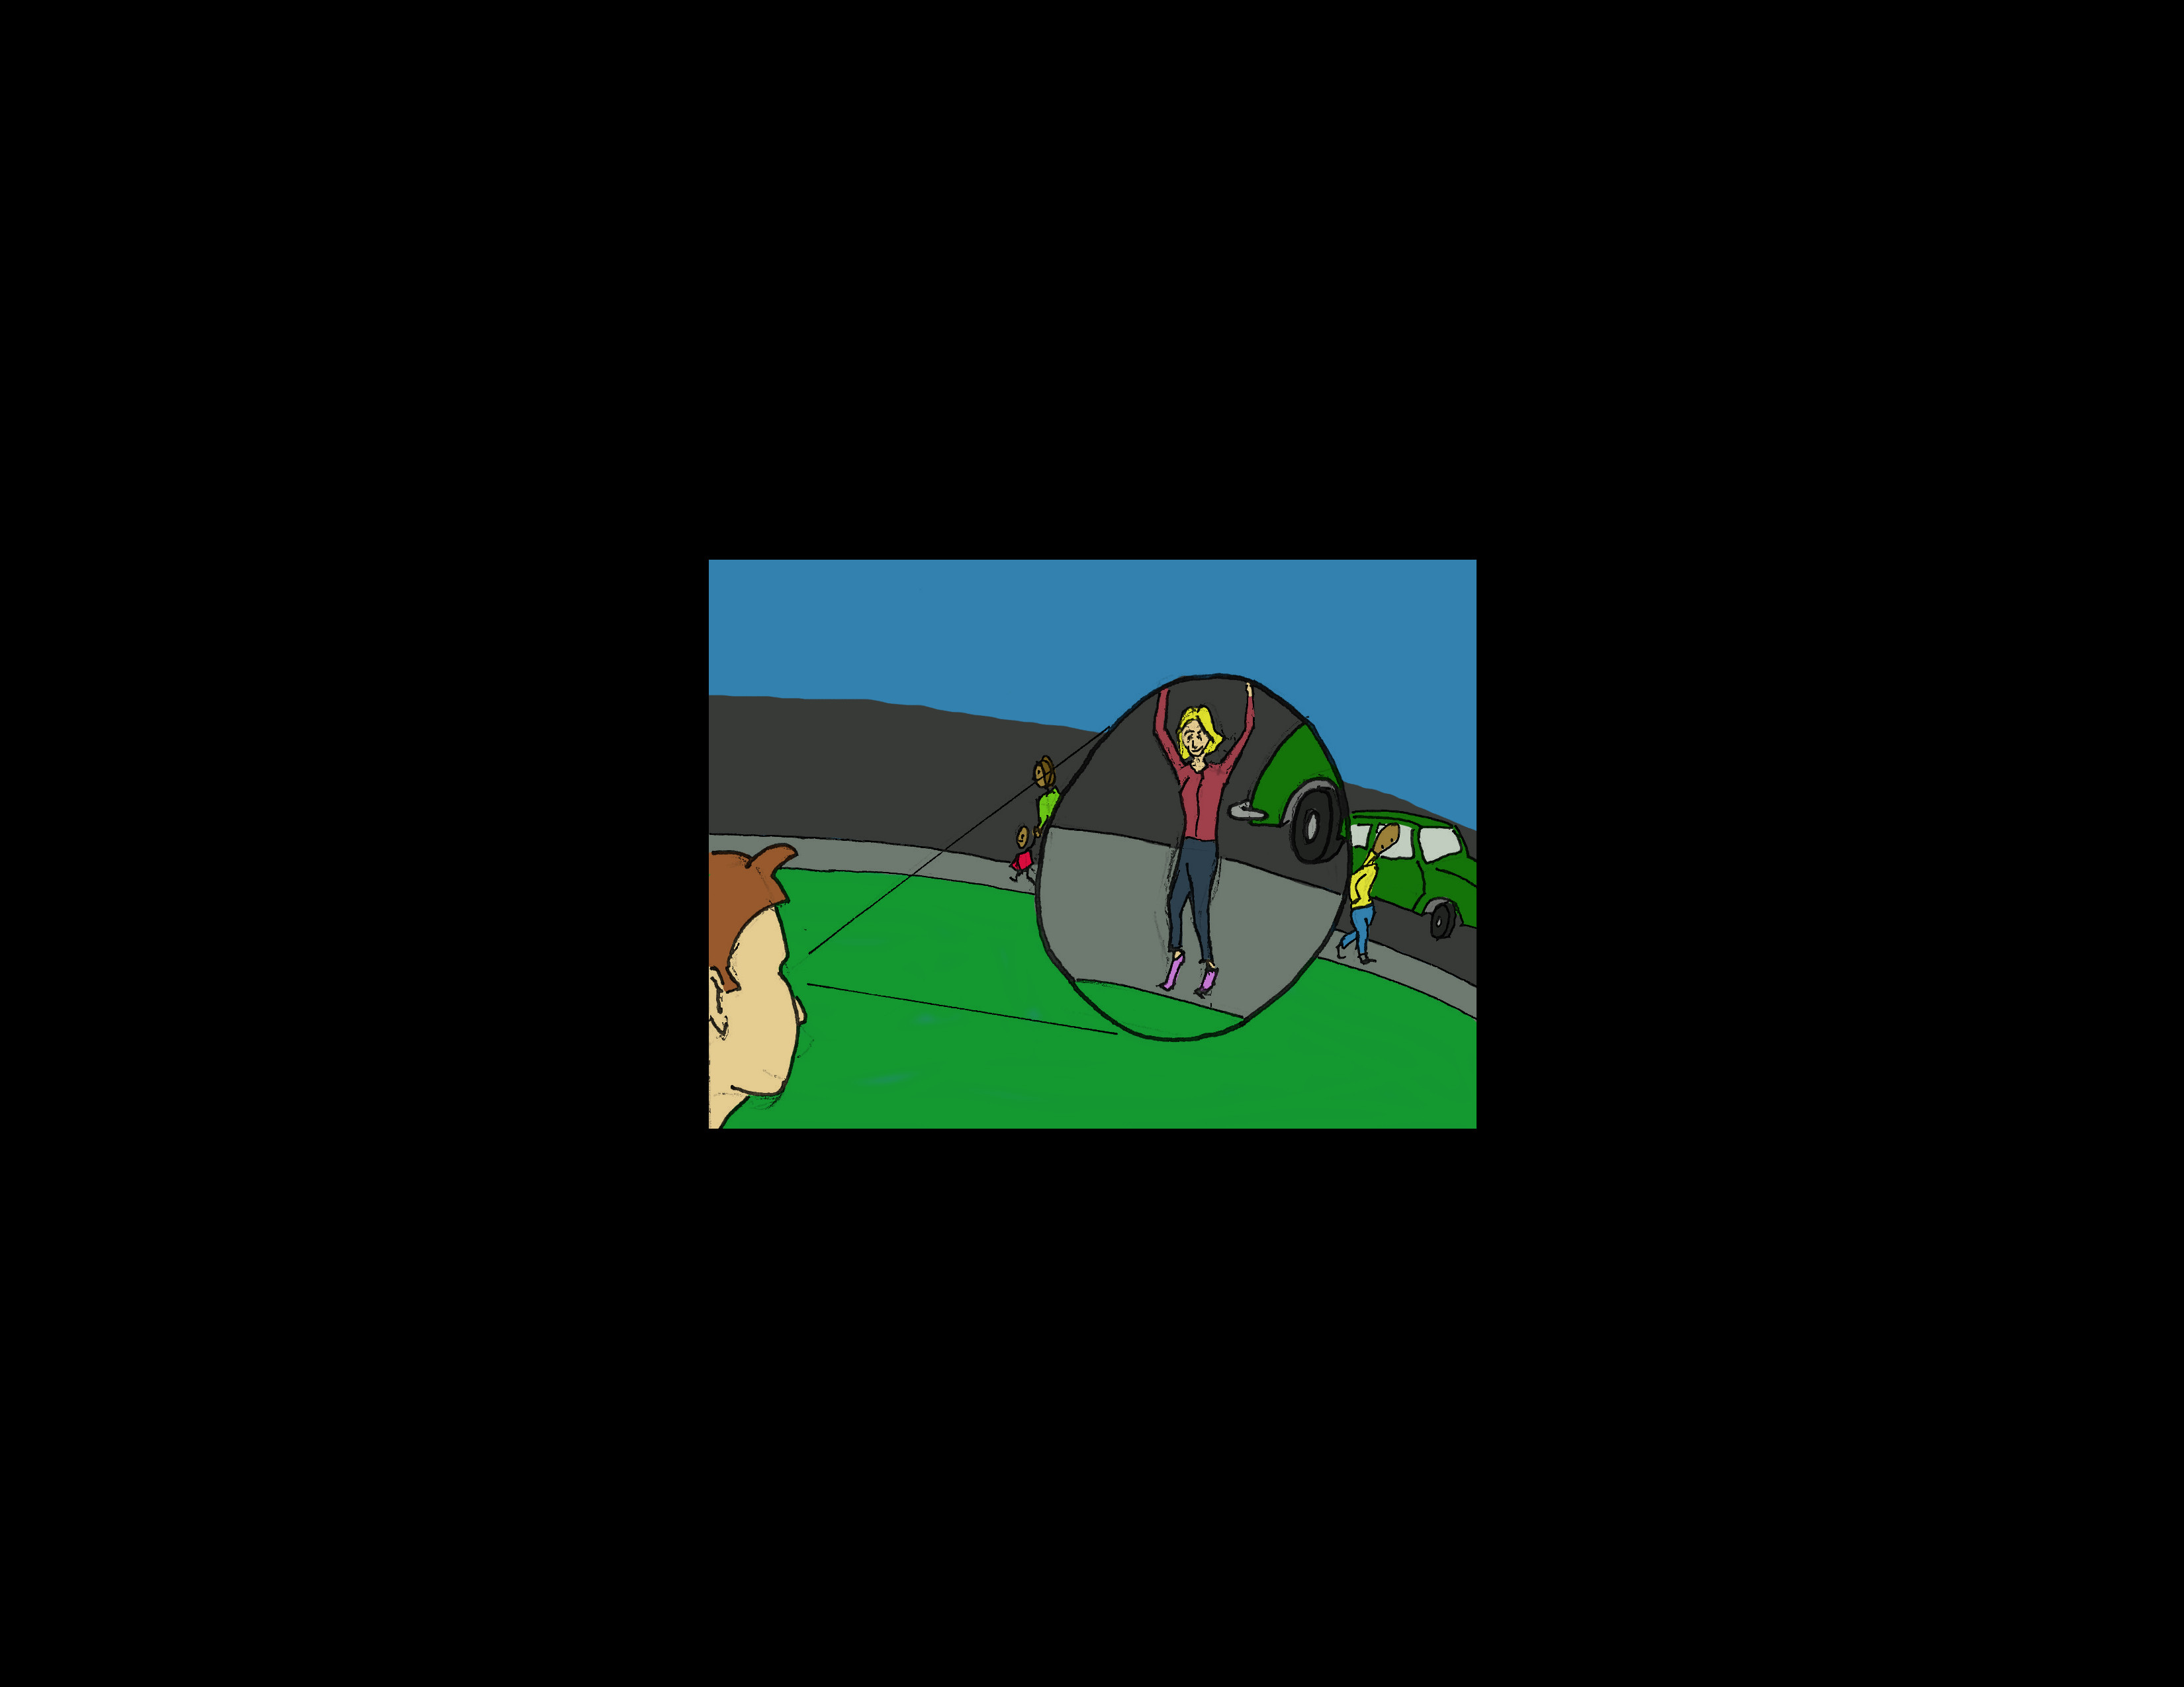
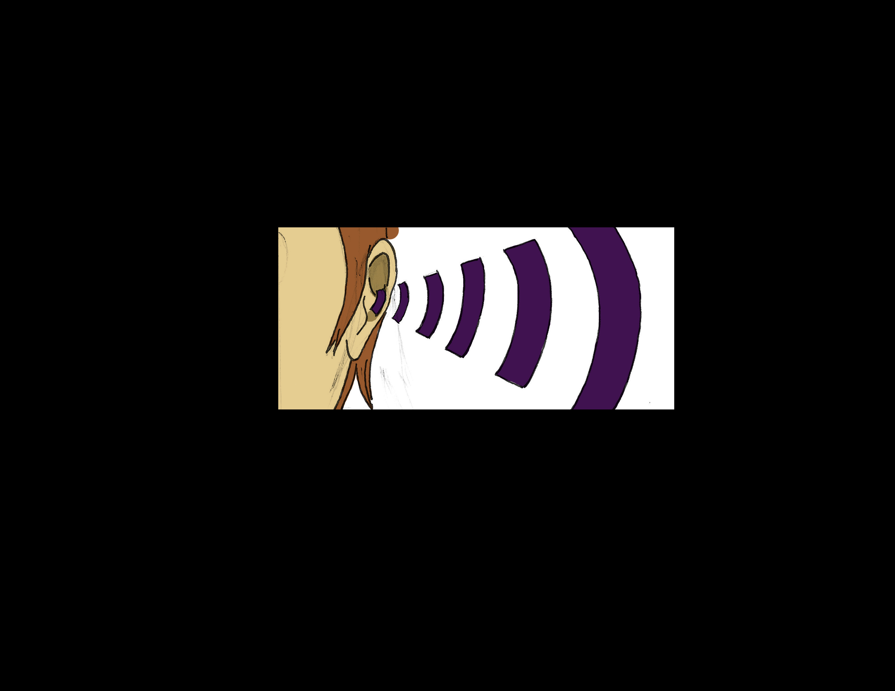
Other dreams are about our senses…
… sight…
… hearing…
Notes:
Intro: Other dreams dealing with senses
Senses we don’t even posess
Senses – Sight – sound – porf X – Spidey - Quickening

Slide 6
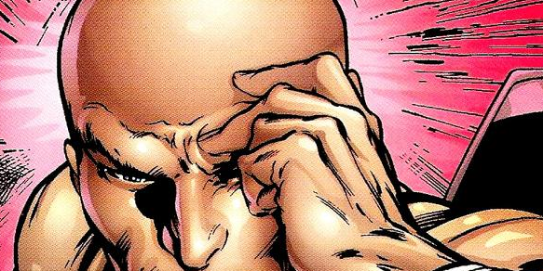
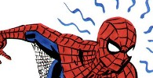
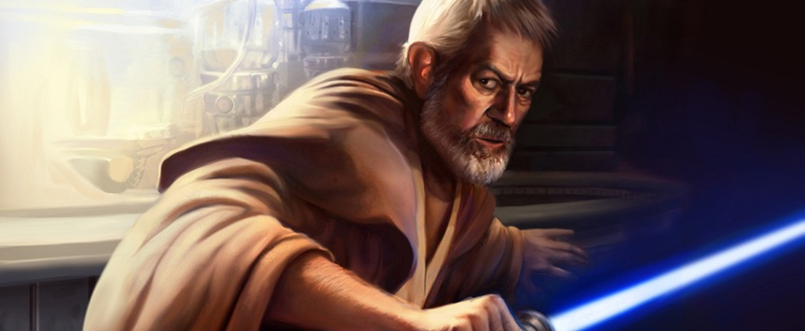
Other dreams are about our senses…
Some are about senses we don’t possess
… sight…
… spidey sense…
… hearing…
… a disturbance in the force.
Notes:
Intro: Other dreams dealing with senses
Senses – Sight – sound – porf X – Spidey - Quickening

Slide 7
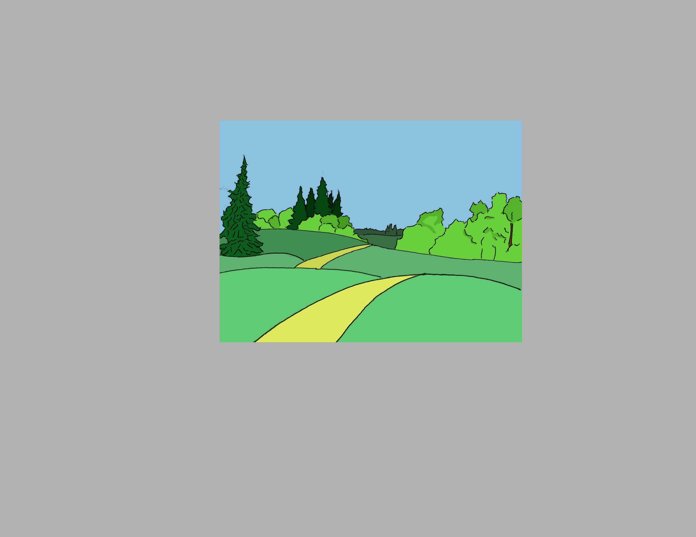
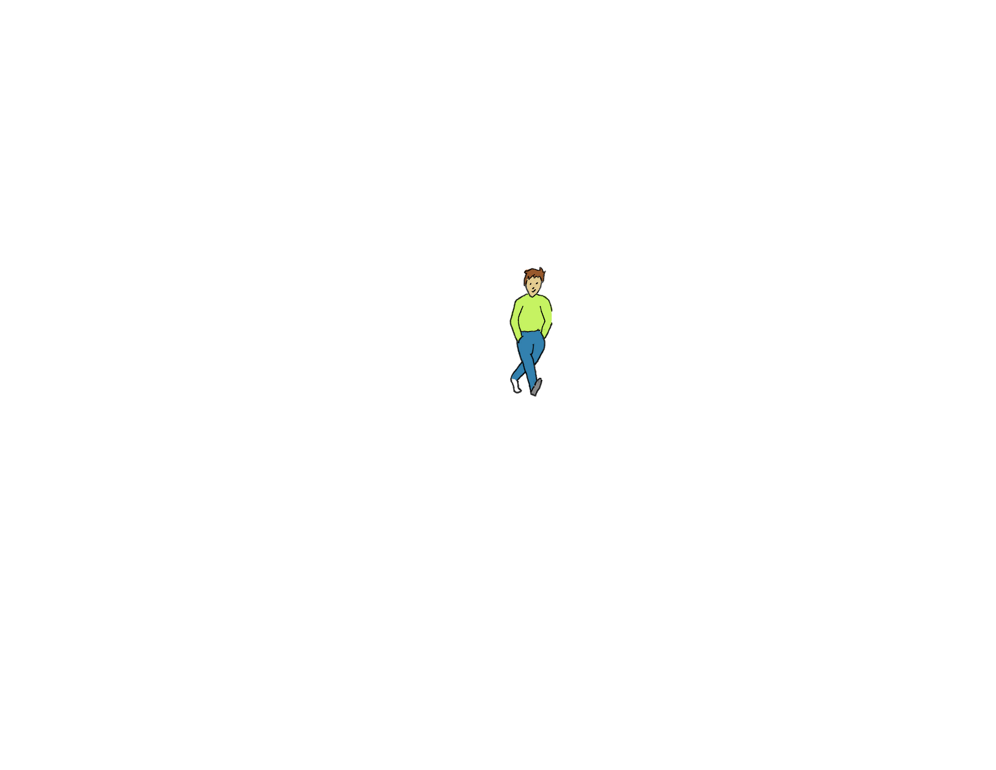
Notes:
We are not super heroes. Just regular people

Slide 8

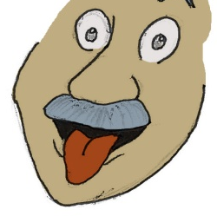

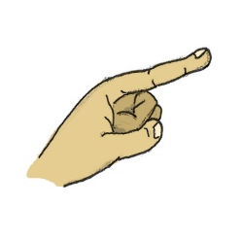
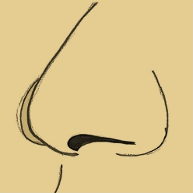
Notes:
With just 5 senses

Slide 9

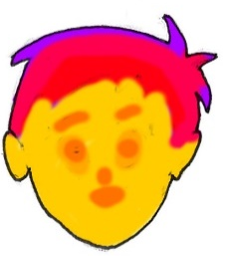

UV Light
IR
radiation
Magnetic fields
Notes:
Intro: More than we can sense
Our 5 senses – IR – UV – Magnetic Waves – WiFi – Cellphone

Slide 10
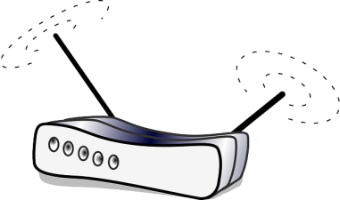
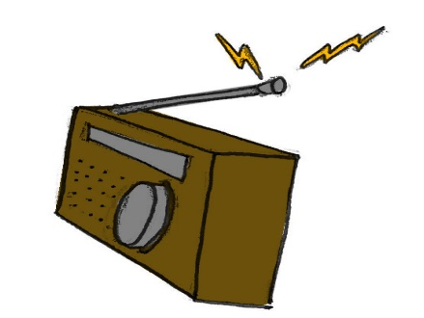
UV Light
WiFi
IR
radiation
RAdio
Magnetic fields
Pollution
Notes:
Intro: More than we can sense
Our 5 senses – IR – UV – Magnetic Waves – WiFi – pollution

Slide 11
UV Light
WiFi
IR
radiation
RAdio
Magnetic fields
Pollution
Notes:
Intro: More than we can sense
Our 5 senses – IR – UV – Magnetic Waves – WiFi – Cellphone

Slide 12
UV Light
WiFi
IR
radiation
RAdio
Magnetic fields
Pollution
Notes:
Intro: More than we can sense
Our 5 senses – IR – UV – Magnetic Waves – WiFi – Cellphone

Slide 13
Background:
Thermal interfaces
Vibration interfaces
Mobile device interfaces
Sensory substitution
New sensory experiences

Slide 14
Background:
Thermal interfaces

Slide 15
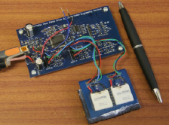
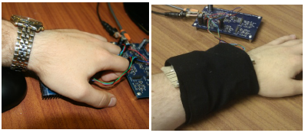
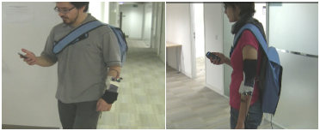
Microcontroller…
On the arm
… and Peltier
On the palm
users detect hot and cold stimuli presented to the fingertips, the palm and the arm
Two studies. One static indoor and one mobile
The experiment was repeated with the subjects walking around
Wilson, G., Halvey, M., Brewster, S. A., & Hughes, S. A. (2011). Some Like it Hot ? Thermal Feedback for Mobile Devices.
Human Factors, 2555–2564. doi:10.1145/1978942.1979316
Notes:
Background: Thermal II
Static: Click the mouse when a change in thermal stimulation was felt. The temp of the peltier was recorded. Then rate the stimulus, “very hot” or “very cold” and “comfortable” and “very comfortable”.
Mobile: Wile walking.

Slide 16
Background:
Vibration interfaces

Slide 17
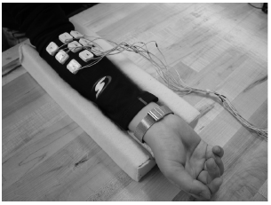
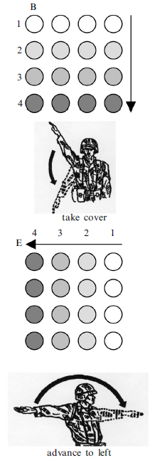
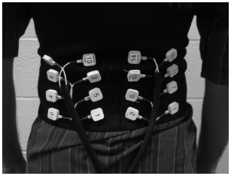
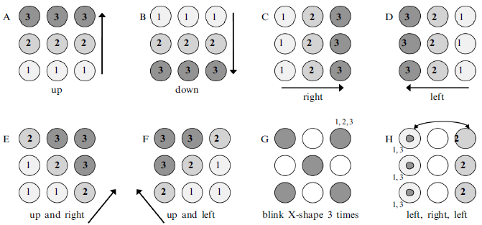
How a tactile display can communicate simple instructions and commands
On the arm
On the back
Simple patterns
Simple instructions
Jones, L. A., Kunkel, J., & Piateski, E. (2009). Vibrotactile pattern recognition on the arm and back. Perception, 38(1), 52–68. Retrieved from http://www.ncbi.nlm.nih.gov/pubmed/19323136
Notes:
Background: Vibration I
Participants would compare the vibration pattern with a cheat-sheet. Accuracy was different per pattern.
Compare patterns that signified hand and arm signals with the dots 98% and without 75%. Even when performing physical or cognitive tasks.

Slide 18
Background:
Mobile device interfaces

Slide 19
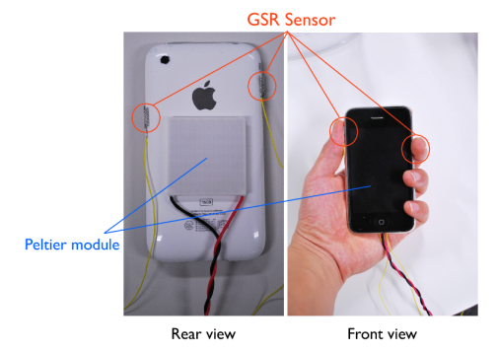
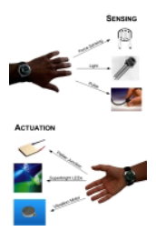
AffectPhone
Peltier delivers warmth or coolnes
detects a user’s emotional state using GSR, and conveys this state via changes in the temperature of the back panel of the other handset
Gsr sensor detects user’s emotions
Iwasaki, K., Miyaki, T., & Rekimoto, J. (2010). AffectPhone: A Handset Device to Present User’s Emotional State with Warmth/Coolness. B-Interface
connexus
Aims to detect various conditions at a time and transmit them in different ways
Detects Pressure, ambient light and heartbeat
Gives heat, light and vibration
Paulos, E. (2003). Connexus: a communal interface. Proceeding DUX ’03 Proceedings of the 2003 Conference on Designing for User Experiences, 1–4.

Slide 20
Background:
Sensory Substitution

Slide 21
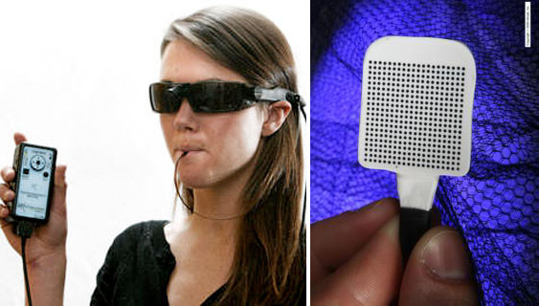
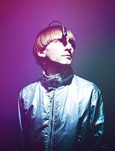
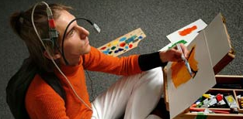
Brainport and eyeborg
Images captured by the camera…
DANILOV, Y., & Tyler, M. (2005). Brainport: an alternative input to the brain. Journal of Integrative Neuroscience, 4(4), 537–50. doi:10.1142/S0219635205000914
… are translated to electrical signals in the tongue
Uses a color sensor and camera to translate…
… color information to sound
Seymour, S. (1965). Cyborg-­‐Evolution of the Superman, (1960), 1–24.
Notes:
Background: Sensory Substitution
-Barinport
-Eyeborg

Slide 22
Background:
Artificial sensory experiences

Slide 23
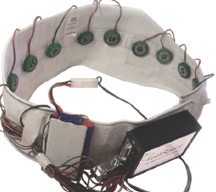
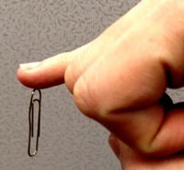
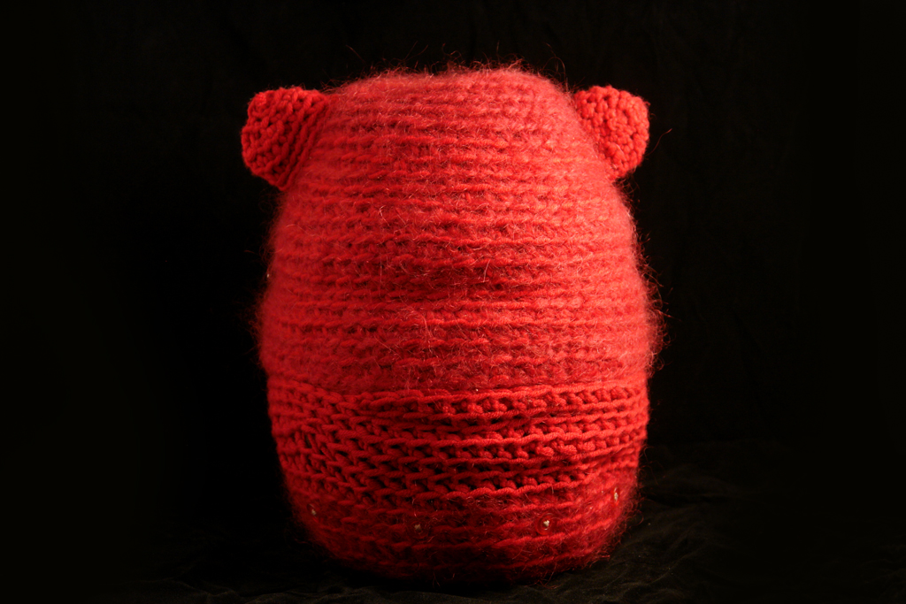
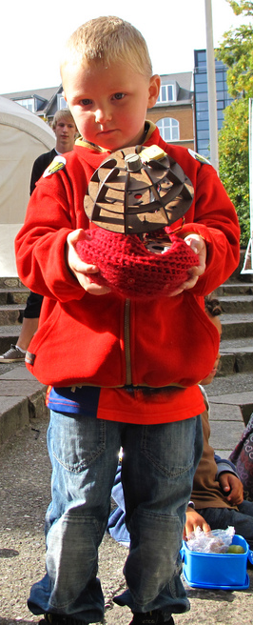
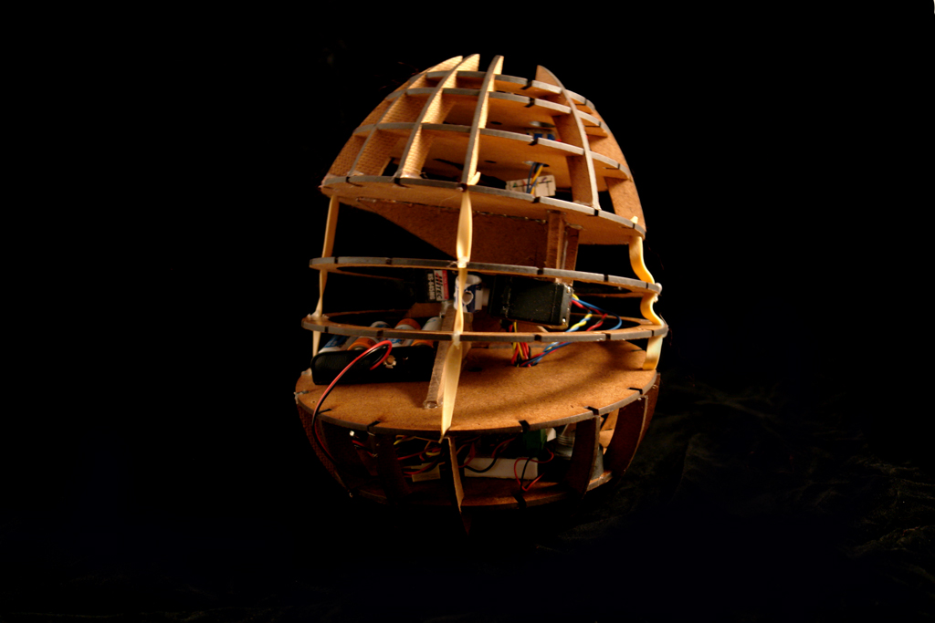
Feelspace belt, body hacking and momo
“feelSpace Belt”
Nagel, S. K., Carl, C., Kringe, T., Märtin, R., & König, P.
“Body Hacking: My Magnetic Implant”
D. Berg
“MOMO: a haptic navigation device”
C. WANG and K. O’FRIEL
Notes:
Baground: new Senses
FeelSpace Belt
Implanted magnets “current INDUCES the magnetic field”
Momo

Slide 24
Digital Synesthesia

Slide 25

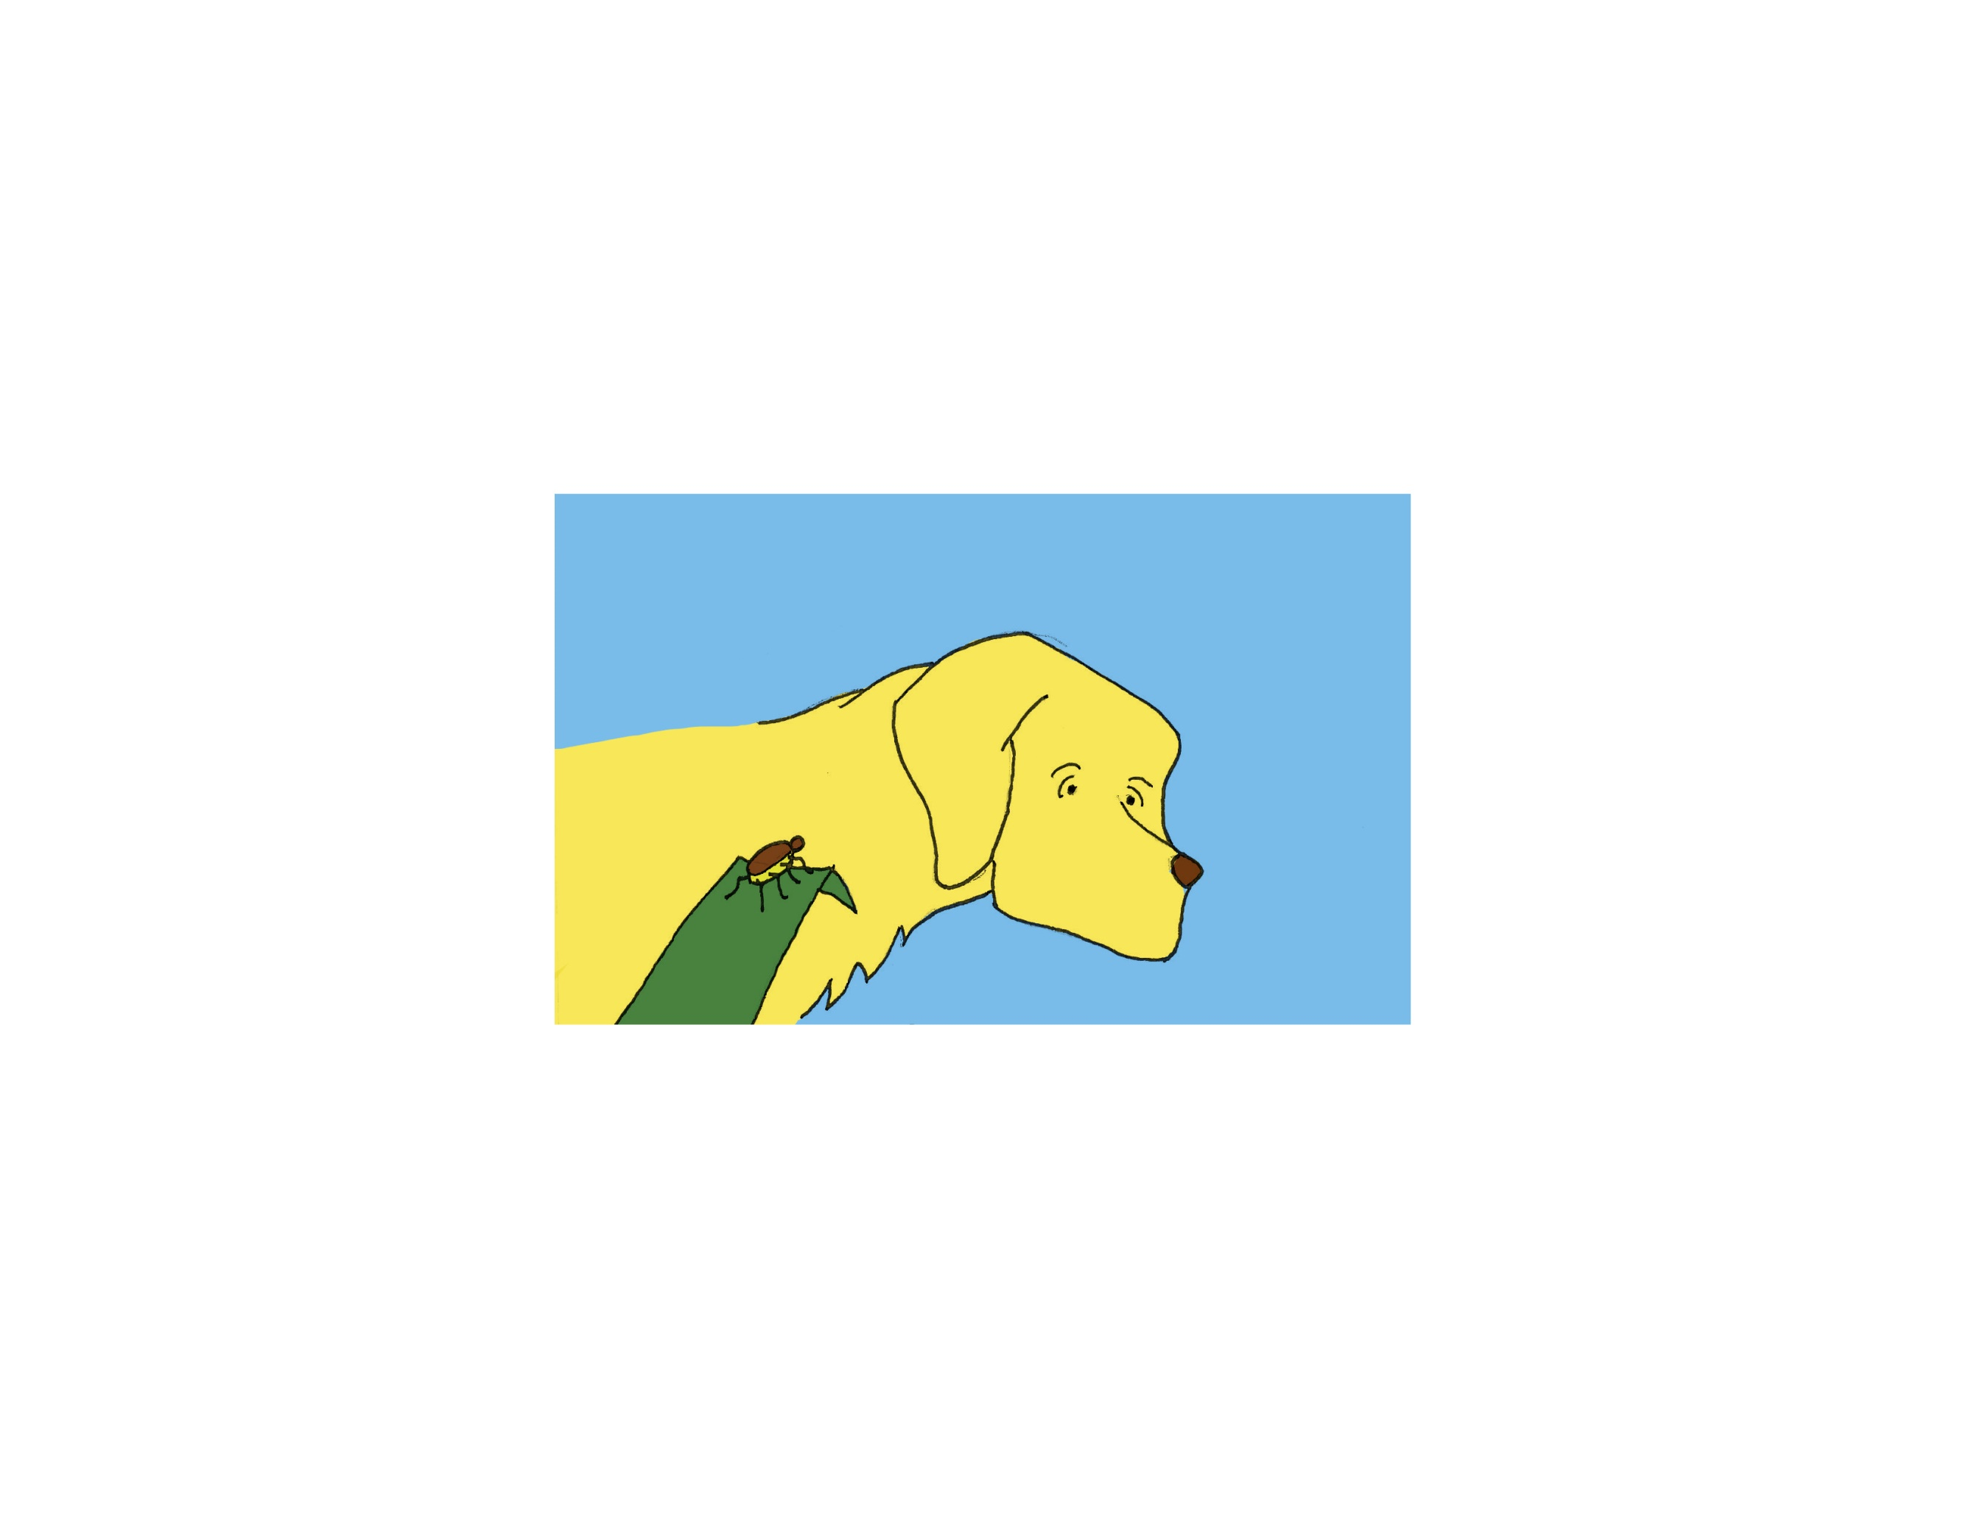

Skin’s light sensitivity to find a tall grass
Sense victim through smell
Jump and hopefully land on animal
The tick understands only three signs
Smell
Temperature
hairiness
Find bald spot and feast
“a foray into the Worlds of Animals and humans”
Jakob von Uexküll
Notes:
Digital synesthesia
Semantic sensory theory
Sensory data as signs
umwelt as the perceptual world in which an organism exists and acts as a subject

Slide 26
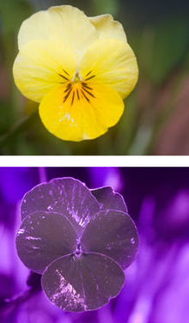
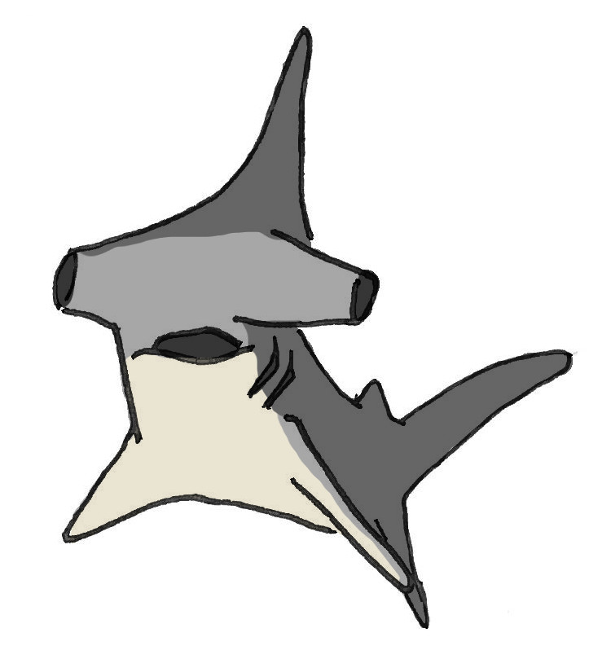
Bees can use uv light to pick flowers
Hammer-head sharks hunt sensing electric signals from the muscles of prey
Notes:
Nth Sense:
The things we could do if we could sense new information?
How would our world perception change?

Slide 27

Bees can use uv light to pick flowers
Hammer-head sharks hunt sensing electric signals from the muscles of prey
Notes:
Nth Sense:
The things we could do if we could sense new information?
How would our world perception change?

Slide 28
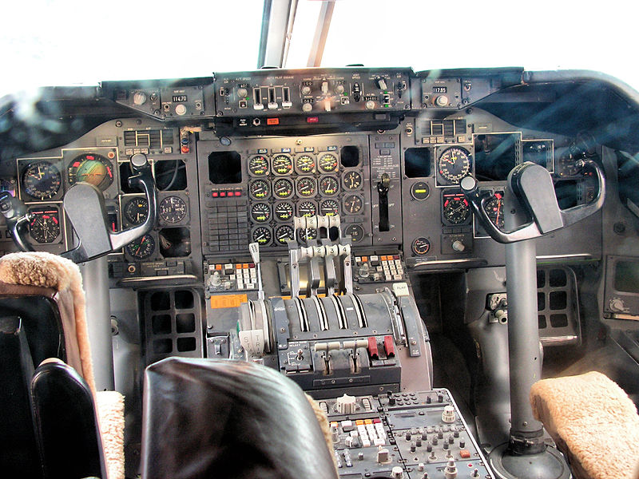
Cognitive load
When by-passing the visual sense, it is easier for the brain to interpret information without shifting attention from current task
Notes:
Background: Interfaces
Situational Awareness

Slide 29
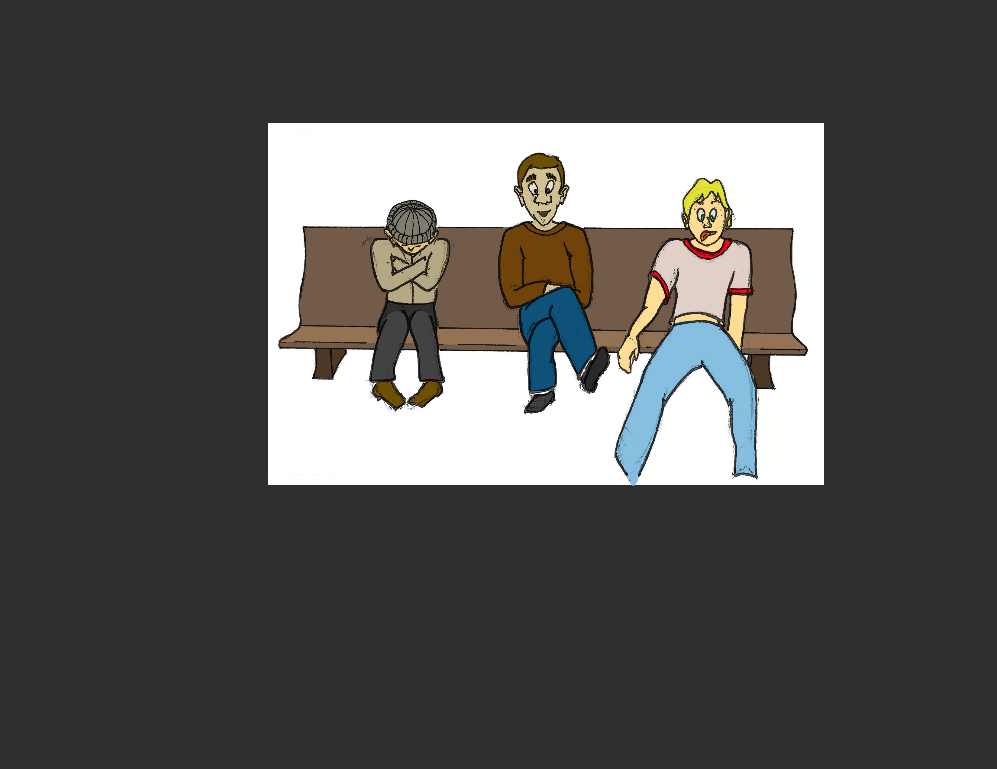

We all feel the same conditions in a different way
Notes:
Get away from teh universal value and bring the personalized feeling

Slide 30
Research questions, stage iv
Discrete and Continuous Data
1. Will a discreet signal (high-low) be more effective than a continuous signal representing changing data?
Sensory Substitution
2. will Digital Synesthesia prove to be a valid alternative to a natural sense when accomplishing the same task?
Sensory Augmentation
3. Will users be able to understand the ability to fine tune the sensitivity of an artificial sense?

Slide 31
Research questions, stage iv
New Senses
4. Is the user able to correctly interpret a new artificial sense that the body previously did not have?
The User and the New Stimuli
5. How accurate is the interpretation of data when experienced through new artificial senses?
6. Will there be feelings of “phantom sense”?

Slide 32

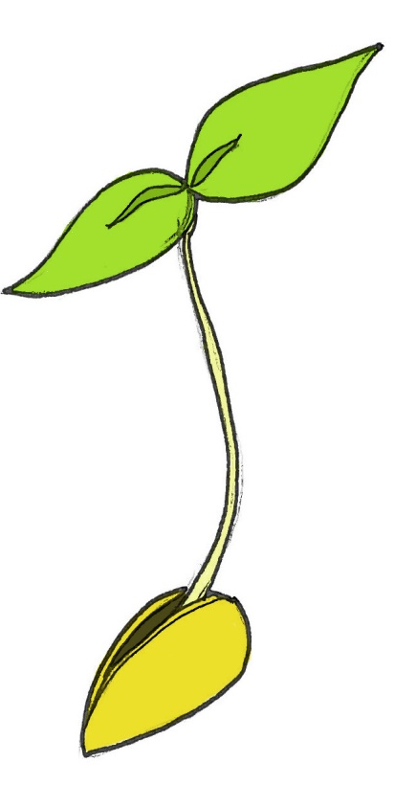
This is only the beginning
Design thinking
… to tree
From Sapling…
What are the design principles and rules that we need to establish to create a new field of…
… artificial sensory interfaces

Slide 33
User Studies
i Proximity sensing:
Artificial experience with High redundancy
ii Temperature sensing:
Artificial sensory experience with no redundancy
iii Mobile sensors:
Artificial sensory experience with unknown context

Slide 34
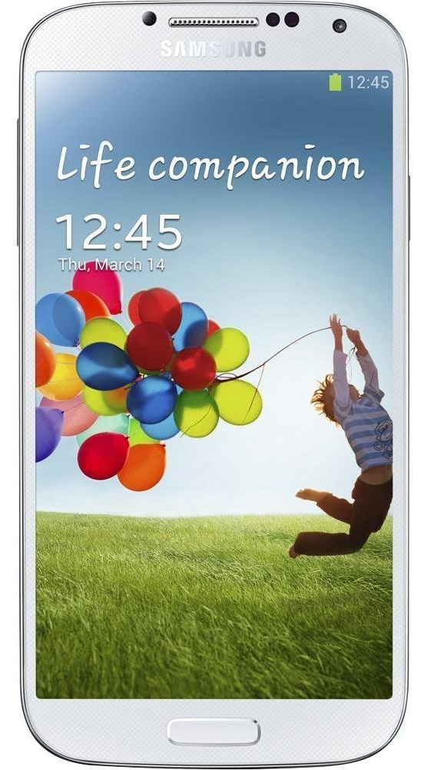
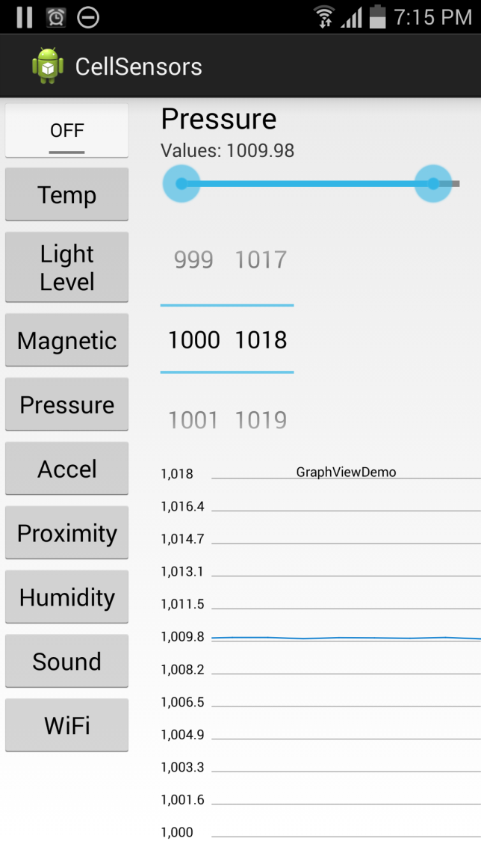
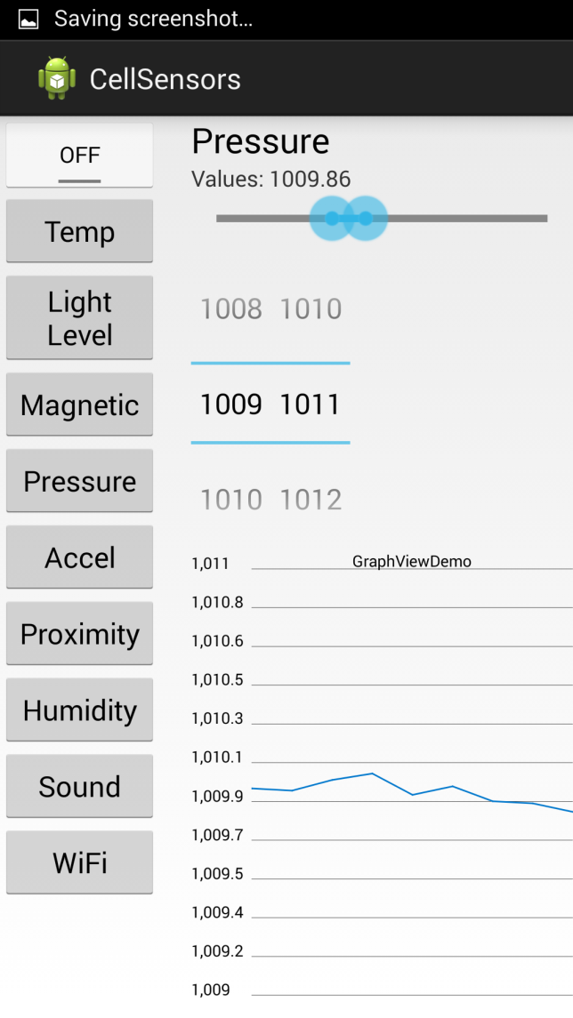
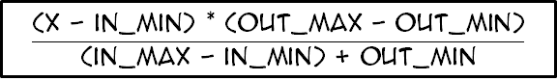
Sensitivity Control
slider
Use the sensitivity dial to change the mapping between the sensed signal and the frequency response
Number Picker
0
100
200
300
400
500
600
700
800
900
1000
$$\frac{\text{(}\text{x}\text{ − }\text{in}\text{_}\text{min}\text{) ∗ (}\text{out}\text{_}\text{max}\text{ − }\text{out}\text{_}\text{min}\text{)}}{\text{(}\text{in}\text{_}\text{max}\text{ − }\text{in}\text{_}\text{min}\text{) + }\text{out}\text{_}\text{min}}$$
X=Sensor Value
In_min, in_max = sensor range
Out_min, Out_max = 0, 1000
mb

Slide 35








Power and ioio
User study i:
proximity
sensor
A proximity sensor and a vibrator
vibrator
The user is asked to identify the number and shapes of the objects on the table
The task was done 3 times. With Bars, flat shapes and volumes.
Notes:
THEY ALWAYS KNOW THE CHOICES THEY HAVE!!!

Slide 36



Results phase one
Users had to identify the number of bars on the table from 0 to 3
N= 17

Slide 37



Results Phase two
circle
rectangle
triangle
N= 17

Slide 38


Results phase three
sphere
cube
prism
N= 17

Slide 39




Outward IR sensor on the forehead
User study ii:
Heat sensing
Inward transducers creates feedback on the forehead
Users are asked to identify which peltier device is warm.
The task is done 12 times.

Slide 40




User study ii:
Heat sensing
Main User Interface
Visual feedback, green for correct…
Red for wrong.

Slide 41

User study ii:
Heat sensing
Second User Interface

Slide 42
Results of second user study
N= 15

Slide 43
Results of second user study
Average time of feedback Vs no feedback
Feedback | Time(sec) | Accuracy
Feedback | 57.99 | 80
No Feedback | 59.93 | 75
Time and Accuracy of the last 6 turns, with and without feedback
Feedback | Time(sec) | Accuracy
No feedback | 58.01 | 66.67
Feedback | 45.95 | 83.33
Time with or without feedback through the study averages out to roughly the same.
Accuracy is slightly higher with feedback
Time with feedback was significantly shorter
Accuracy is significantly higher with feedback

Slide 44





Baseball cap equipped with a transducer…
User study iii:
Cell sensors
transducer
… that responds to the sensors in the mobile device.
Users had 15 minutes to explore the lab…
… and figure out what their artificial sense was responding to.
Notes:
USERS DID NOT KNOW THE POSSIBLE SENSORS AVAILABLE!!!

Slide 45
Results of third user study
N= 17
The wrong responses
Sensor | Response | N=
Sound | Wind or weather related | 4
Pressure | Has to do with the stairs. Shape, Distance or Materials | 4
Temperature | No Idea | 3
Accelerometer | Screens or Bluish light | 3

Slide 46
Other Studies
Smell Explorations
A gaming Scenario
Temperature as output

Slide 47



An off-the-shelf automatic air freshener Is modified to respond to the foodcam feed
Smell experiences i:
foodcam

Slide 48


Smell experiences ii:
Smell mixer
Following principles of perfumery we created a smell mixing device.
The system will activate the essential oils intermittently during 20 seconds.
Pick Base bottle
Pick top bottle
Choose mix ratio

Slide 49




A peltier device on the neck gave feedback…
… to the location of the subject in the lab
Temperature as feedback
Peltier
the peltier will react according to the screen I’m next to.
The screen can recognize the person
Notes:
Important to stablish a base line and to test also vibration and temperature

Slide 50
Design thinking

Slide 51


Design Thinking
1. What is the Main Activity?

Slide 52

Design Thinking
active
2. what type of sensing experience will be created?
passive
Notes:
Active or Passive Sensing

Slide 53


Design Thinking
Smooth but needs constant attention
3. What kind of signal are we tracking?
Slow, gradual, long term
Choppy but long term
Notes:
Does it change quickly or slowly, do we need to feel the changes or just a threshold.

Slide 54
Design Thinking
Full control
4. what control does the user have over the signal?
No control just monitoring
Notes:
No control like weather or wind direction
Some control like speed or tilt of boat
Full control like sensor on hand

Slide 55

Design Thinking
5. Are there any redundancies?
Redundancies help with learning and accommodation
Notes:
Can you confirm with a natural sense what you feel.
Important for training and learning.

Slide 56




Design Thinking
6. what type of feedback?
Notes:
Vibration and Sound are good for quick changing data in short spans of time
Temperature is good for long term monitoring of slow changing data and threshold data.

Slide 57


Design Thinking
Actuator and sensor
7. Where to locate the sensors and actuators?
If the user can’t see the sensor, the sensor and actuator must be in the same place
If the user can see the sensor, the sensor and actuator can be separate and independent
actuator
sensor
Notes:
Location depends on the control over the sense and whether there is visual confirmation of position of the sensor.

Slide 58


Design Thinking
8. Can we set up a learning environment?
A hands on training with redundant artificial sensors
Real situation with artificial sensor only
Notes:
If a learning environment can be designed, then the adoption of the sense will be more successful.
The learning environment should allow for redundancies and visual contact of the sensor when possible and for some immediate feedback of outcome.

Slide 59
Design Thinking
Main activity
Type of signal
Type of sensing
User control
redundancies
Type of feedback
Location of sensor and actuator
Learning environment
Notes:
If a learning environment can be designed, then the adoption of the sense will be more successful.
The learning environment should allow for redundancies and visual contact of the sensor when possible and for some immediate feedback of outcome.

Slide 60

Future vision
Mobile app that will allow for connecting different sensors to actuators on your body.

Slide 61


Future vision
Specialized garments will come with both sensors and actuators ready to be controlled and connected with the mobile device

Slide 62

Future vision
The creation of sensory experiences in the virtual world will be enforced by training in the physical world

Slide 63
contributions
Proven that a user can accurately use an artificial sense with a short time to learn it
Shown the ability of the brain to overcome issues with the quality of the signal or the hardware.
Shown that digital synesthesia will be a feasible interaction paradigm for a general user group
Established a set of recommendations for the implementation of artificial sensory interfaces

Slide 64
The end
Thank you…
Questions?

Slide 65

Mobile devices offer connection…
Notes:
Connection and bennefits

Slide 66
Mobile devices offer connection…
… and also distraction
Notes:
Distraction and demand attention
Immersive experiences / interfaces / media

Slide 67

Mobile devices offer connection…
Digital synesthesia will create an immersive experience in the real world…
… and also distraction
… again!
Notes:
Intro Why!
Immersion in the real world

Slide 68


Nature signals
Mobile device translates
Human Made
Notes:
Intro: Mobile Device as translator
Some go to the user – Some go to the phone and then to the user.

Slide 69


Different material are placed in the device
The pressure and temperature change of the finger was measured
The subject must identify the warmer and colder of the two
Development of thermal displays and understanding the nature of thermal cues.
“Material discrimination and thermal perception”
L. A. Jones and M. Berris
Notes:
Background: Thermal I
- Pressure on sample and relative temperature between finger an material are measured
- Two materials treated to have no recognizable textures would be inserted for the subject to identify the warmer from colder.

Slide 70




No need for positioning, the system detects structured light.
Full implementation of the system
Optical-haptic substitution
“SenseableRays: opto-haptic substitution for touch-enhanced interactive spaces”
J. Rekimoto
Notes:
Background: Vibration II
-Senseable Rays: Small and directly converts time-modulated light signals from a projector into haptic sensations.

Slide 71

Situational awareness
Take information from the environment, integrate it with previous knowledge and form a coherent mental picture
Notes:
Background: Interfaces
Situational Awareness

Slide 72



User wears a head band with a temperature sensor
Temperature and stress
When sensor would not pick up from afar, it was set up very close to the face
A game of liar’s dice

Slide 73
Temperature and stress
The collected data showed no significant changes

Slide 74
Temperature and stress

